Slide 1

Welcome to Java!

Slide 2
Topics
Why Java?
Classes and Objects
Hello World Application
Primitive Data Types
Arrays
Stack VS Heap
Strings
Type Conversion and Casting
Operators

Slide 3
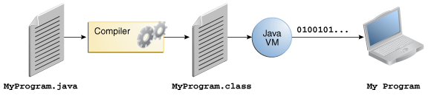
Why Java?
Portable
Simple syntax
Based on C
Rich API
Java is FREE
Support from Oracle Corporation
Automatic memory management
No pointers!

Slide 4


Classes and Objects
Class is a blueprint that defines:
State (variables)
Car has wheels.
Behavior (methods)
Car can drive.
State and behavior are called “class members”
Object is an instance of a class
Objects are created from class blueprints
2005 Honda Civic is a Car
Notes:
State involves NOUNs
Behavior involves VERBs

Slide 5
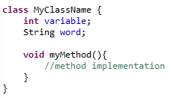
Basic Class Structure

Slide 6


Hello World!

Slide 7
Primitive Data Types
boolean N/A True or False
byte 1 byte -128 to 127
char 2 bytes 0 to 65536
double 8 bytes 1.7e-308 to 1.7e+308
int 4 bytes -2,147,483,648 to 2,147,483,647
long 8 bytes -9,223,372,036,854,775,808 to 9,223,372,036,854,775,807
float 4 bytes 3.4e-308 to3.4e+308
short 2 bytes -32,768 to 32,767

Slide 8
Arrays
Array is a group of variables
Elements of an array must be the same type
variable = new int[5];
OR
int[ ] items = {1, 2, 3, 4, 5};
Elements are accessed by an index
items[0] = 1;
items[3] = 4;
Find an array’s size with arrayName.length
items.length

Slide 9
2-D Arrays
int variable[][] = new int[2][3];
Index Locations in a 2-D Array
variable[0][2] = 5;
variable[1][1] = 10;
[0][0] | [0][1] | [0][2]
[1][0] | [1][1] | [1][2]
 |  | 5
 | 10

Slide 10
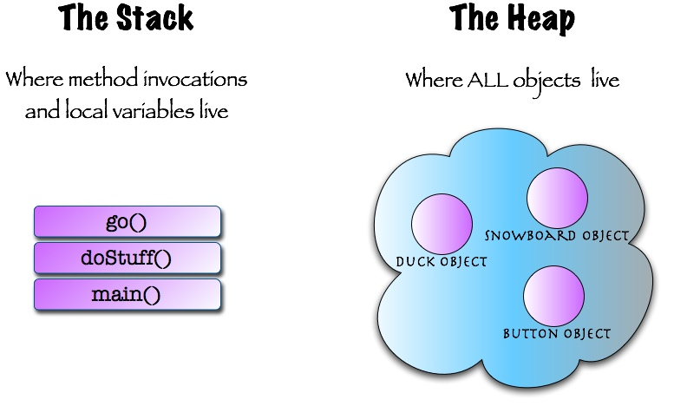
Stack VS Heap

Slide 11
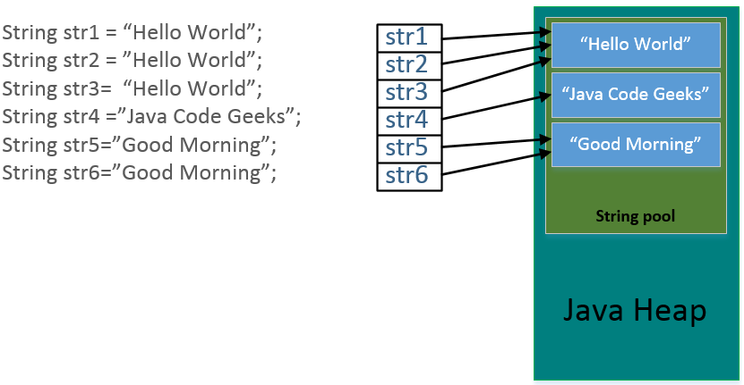

String
String is a special Java class
String words = new String(“Hello World”);
OR
String words = “Hello World”;
Strings are immutable
Strings go to the String Pool

Slide 12
Type Conversion and Casting
Convert a variable from one type to another (explicit or implicit)
Explicit conversion (must be done with casting):
int variable = 10;
byte item = (byte) variable;
Implicit conversion:
byte item = 10;
int variable = item;
You can cast objects, too!
Dog dog = new Dog( );
dog = (Animal) dog;

Slide 13
Operators
+ ADDITION
- SUBTRACTION
* MULTIPLICATION
/ DIVISION
% MODULUS
++ INCREMENT
-- DECREMENT
+= ADDITIONASSIGNMENT
-= SUBTRACTION ASSIGNMENT
%= MODULUSASSIGNMENT

Slide 14
Relational Operators
== EQUALTO
!= NOT EQUAL TO
> GREATER THAN
< LESS THAN
>= GREATER THAN OR EQUALTO
<= LESS THAN OR EQUAL TO

Slide 15
Boolean Logical Operators
& LOGICAL AND
| LOGICALOR
&& SHORT-CIRCUITAND
|| SHORT-CIRCUITOR
! LOGICALUNARY NOT

Slide 16
Ternary Operator
? TERNARY OPERATOR
A quick “if-else” expression
int k = 10;
int m = k > 6 ? 1 : 0;
k greater than 6? Then m = 1. Else m = 0.

Slide 17
Review
Why Java?
Classes and Objects
Hello World Application
Primitive Data Types
Arrays
Stack VS Heap
Strings
Type Conversion and Casting
Operators

Slide 18
Assignment
Write a program to add, subtract, multiply and divide two non zero hard-coded numbers.
Write a program to search for the greatest of three numbers using Short-circuit Operators and print the result.
Write a program –declare two variables a and b and initialize them to true and false respectively. Get the output of the following computations:
!a
a | b
(!a & b) | (a & !b)
Never delete your practice projects. You never know when you need to reference that code!

Slide 19
Intro to Java Syntax

Slide 20
Topics
Control Statements
if
switch-case
for
while
do-while
break
continue
More on Java classes and objects
Stack and Heap
Method calls
Methods with parameters
Parameters vs Arguments

Slide 21
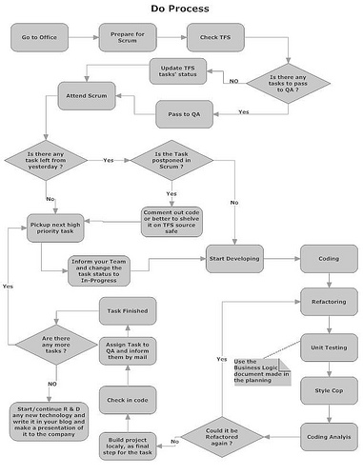
Control Statements
if
switch-case
for
while
do-while
break
continue

Slide 22
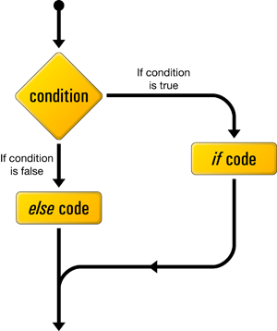
If/Else
int a = 0;
if (a > 5){
System.out.println(“greater than 5”);
}
else{
System.out.println(“less than 5”);
}

Slide 23
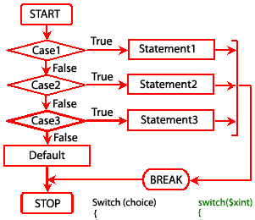
Switch/Case
int i = 2;
switch(i) {
case 0:
System.out.println(“Zero”);
break;
case 1:
System.out.println(“One”);
break;
case 2:
System.out.println(“Two”);
break;
default:
System.out.println(“greater than 2”);
}

Slide 24
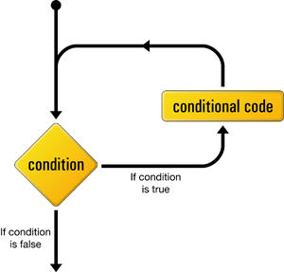
While Loop
int num = 1;
while (num < 10) {
System.out.println(num);
num++;
}

Slide 25
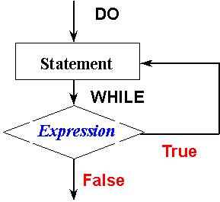
Do/While Loop
int num = 1;
do {
System.out.println(num);
num++;
} while(num < 10);

Slide 26
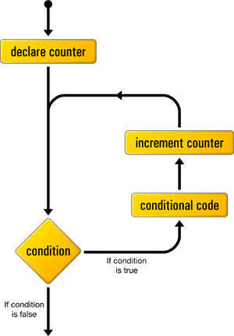
For Loop
for (int num = 0; num < 10 ; num++)
{
System.out.println(num);
}

Slide 27
Enhanced For Loop
int[ ] items = {1, 2, 3, 4, 5};
for (int element : items)
{
System.out.println(element);
}
“int element” declares a local variable
At the end of the block:
Loop moves to the next element in the array
For each element in “items”

Slide 28
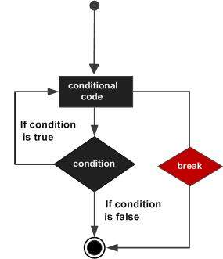
Break
for (int a = 0; a<10; a++){
if (a == 5) break;
System.out.println(a);
}
System.out.println(“Loop complete!”);

Slide 29
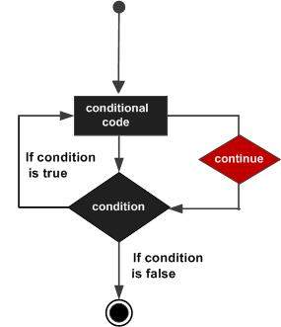
Continue
for (int i = 0; i< 10; i++){
if (i == 5) continue;
System.out.println(i);
}

Slide 30
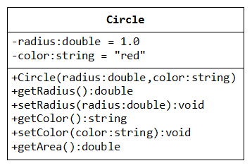
Class
class MyClass{
// instance variables
int variable;
// methods
void myMethod(){
}
}

Slide 31
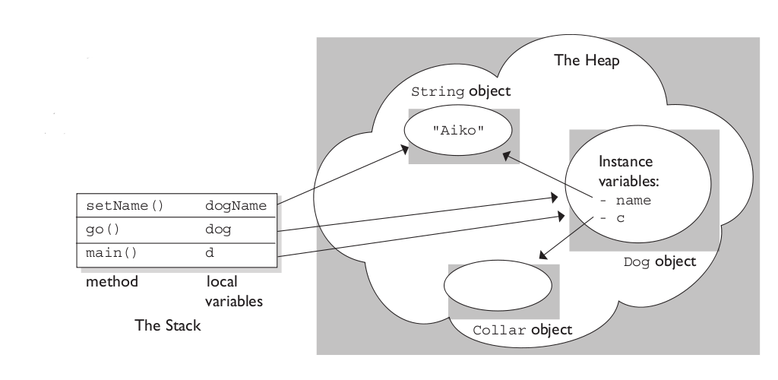
Objects and Methods
Create an object of a class:
MyClass ref = new MyClass( );
Objects let you call methods
ref.myMethod( );
Every method has a return type
String
int
An Object
If not, return type is void
void myMethod( ){
}

Slide 32
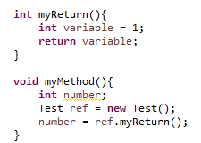
Return
In a method use:
return someVariable;
Return Statement will:
Terminate the local method
Pass the value to where the method was called
Example:
You can use return multiple times
The first one that is reached is used

Slide 33


Parameterized Methods
Methods may take parameters of any data type
Methods may take any number of parameters
Values passed into parameters are called arguments

Slide 34
Review
Control Statements
if
switch-case
for
while
do-while
break
continue
More on Java classes and objects
Stack and Heap
Method calls
Methods with parameters
Parameters vs Arguments

Slide 35
Assignment
Write a program to add, subtract, multiply and divide two numbers using methods with parameters using only one class.
In one project, create two classes. One class should contain only methods (add, subtract, multiply and divide). The other class should contain only the main() method which calls each of the methods from the previous class.
Create an example for each control statement.

Slide 36
Members, Modifiers, and More

Slide 37
Topics
Access Modifiers
Constructors
Overloaded Constructors
Overloaded Methods
Static Members
Final
String API
Command Line Arguments

Slide 38
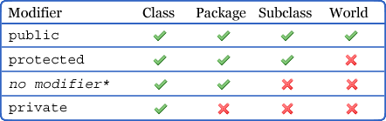
Access Modifiers
public
protected
default (no modifier)
private

Slide 39



Applying Access Modifiers
Class:
Method:
Variable:
Constructor:

Slide 40
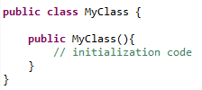
Constructors
The constructor is called using the new keyword
A constructor initializes an object immediately
It has the same name as the class
It looks like a method
It has no return type
It can accept parameters
The JVM creates a “default constructor” if you do not provide one

Slide 41
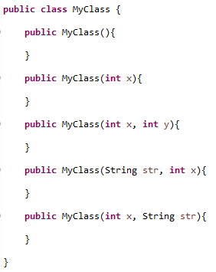

Overloaded Constructors
A class may have more than one constructor
Each constructor must take in different arguments
Arguments can be of any data type or object
The order of the arguments matters!
A constructor without arguments is generally called:
“No-arg” constructor
A no-arg constructor is NOT the default constructor

Slide 42
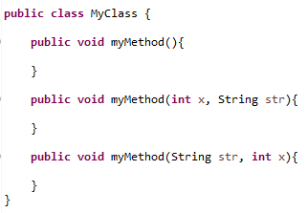

Overloaded Methods
Overloaded methods have:
The same signature
Different parameters
Arguments can be of any data type or object
The order of the arguments matters
Changing the return type alone will not work!
The method call would be ambiguous
Notes:
Method overloading is a type of “compile-time polymorphism”

Slide 43
Static Members
Static variables
Shared by all instances of that class
Changing value in one object is seen by all others
Static methods
Method calls do not require an object
MyClass.myStaticMethod( );
Static block
Also known as the “static initializer”
Block of code run by the JVM at Class Loading
Used to initialize static variables
Non-static variables cannot be referenced from a static context
int b=2
Object 1
int a=1
Object 2 int a=2

Slide 44
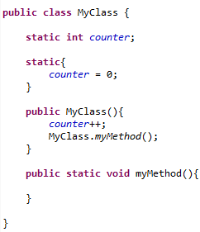
Static Examples
1
2
3
4

Slide 45

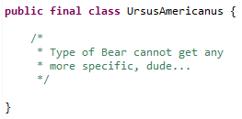

Final
Final variables
Cannot be changed once initialized
Constant value
Typically written in all uppercase
Final methods
Cannot be overridden
Final classes
Cannot be extended
The last leaf on the “Animal”
Inheritance tree
Who… me?

Slide 46
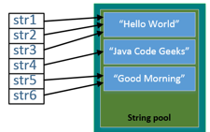
String API
The String class is final
String objects are immutable
Remember the String pool?
String objects are constructed as:
A byte[ ] array
A char[ ] array
String class has many String manipulating methods:
equals(Object ref)
charAt(int index)
toUpperCase( )
toLowerCase( )
Find a String’s length with the “length” variable:
myString.length

Slide 47

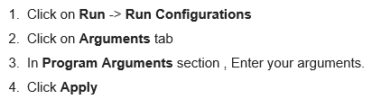
Command Line Arguments
Command line arguments
Pass as arguments into main( ) method
Values are passed as Strings
Entered through the command line:
Windows Command Prompt
Linux/UNIX shell
Macintosh Terminal
Entered through an IDE:
Type a space between each argument

Slide 48
Review
Access Modifiers
Constructors
Overloaded Constructors
Overloaded Methods
Static Members
Final
String API
Command Line Arguments

Slide 49
Assignment
Write a program that prints all Strings passed through the command line.
(Hint: loop through main(String[ ] args))
Create a new Java project
Create a Customer class with:
At least 2 constructors
At least 2 overloaded methods
At least 1 static variable
At least 1 final variable
Create a main method in a new class that:
Creates 2 customers
Uses each of the Customer class members

Slide 50
Intermediate Concepts

Slide 51
Topics
Abstraction (Abstract classes and methods)
Encapsulation
Inheritance
Polymorphism
Method Overriding
Constructor execution sequence
Packages
Import Statements
Introduction to Interfaces

Slide 52
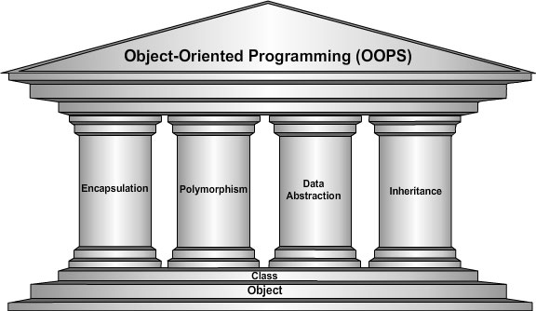
Four Pillars of OOP

Slide 53
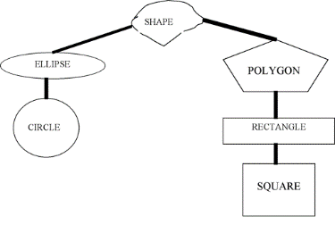
Abstraction
Centralize common characteristics
Reduce complexity
Increase coding efficiency
Eliminate duplicate code
Generalize behavior into conceptual classes
Provide a template for other classes

Slide 54
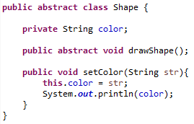
Abstract Keyword
Abstract classes and methods use the abstract modifier
Abstract classes cannot be instantiated!
An abstract method does not have a body
No braces or implementation
Terminated with semicolon
Abstract class can have both:
Abstract methods
Concrete methods

Slide 55
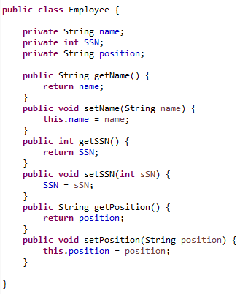
Encapsulation
Restriction of access to class members
Class members packaged into one component
Variables declared private to hide data
External classes retrieve data through public methods
Maintains boundaries between components
Separation of concerns

Slide 56
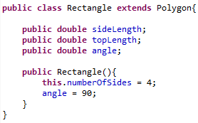
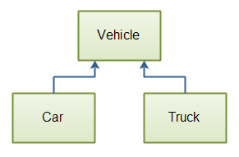
Inheritance
A class can inherit members from another class
A class can extend another class’s functionality
The class that extends another is called a sub-class
Also called child class
The class that is extended is the super-class
Also called parent class
Car IS A Vehicle
Truck IS A Vehicle

Slide 57


Polymorphism/Method Overriding
From Greek:
πολύς, polys, "many, much"
and μορφή, morphē, "form, shape”
A class can take many forms
Polymorphism is achieved through:
Subclasses
Method overriding
Methods in a subclass override a parent:
When the method signature is identical
When the method has the same parameters
Notes:
Method overriding is a type of “run-time polymorphism”

Slide 58

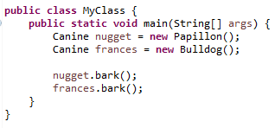


Polymorphism in Practice
Deep, intimidating bark!
Tiny, yappy bark!

Slide 59
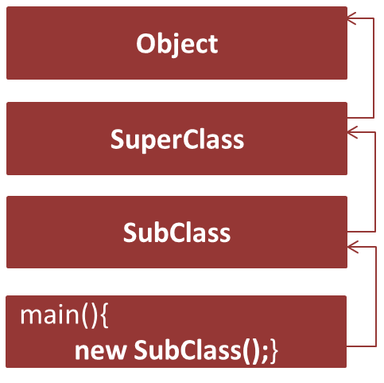

Constructor Execution
When an object is constructed, the JVM calls:
super( );
Calls the no-arg constructor of its parent
This continues to chain up the tree
When the Object constructor is called…

Slide 60

Packages
A package is a folder to organize Java class files
The package statement declares where your class resides
The package statement is Line 1 of every class
A best practice is to use “reverse domain naming”

Slide 61
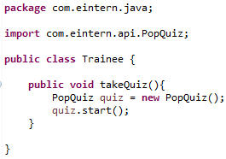
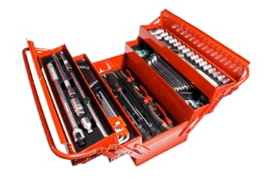
Imports
Used when code is outside the current package
Imports utilities from the Java API
Imports classes from various frameworks
Necessary step to using tools in your arsenal

Slide 62
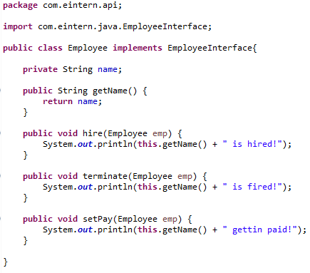
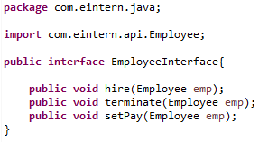
Interfaces
Interfaces are blank templates
Used to define class behavior
Enforce behavior from subclasses
Hide implementation details
Act as a contract for others to use your code
A class implements an interface

Slide 63
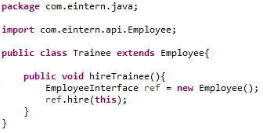
Interfaces
Anyone can use your code without understanding the complexity!
Why? Polymorphism!
Interfaces are used widely in:
Spring
Hibernate
EjB
WebServices
And many more frameworks!

Slide 64
Review
Abstraction (Abstract classes and methods)
Encapsulation
Inheritance
Polymorphism
Method Overriding
Constructor execution sequence
Packages
Import Statements
Introduction to Interfaces

Slide 65
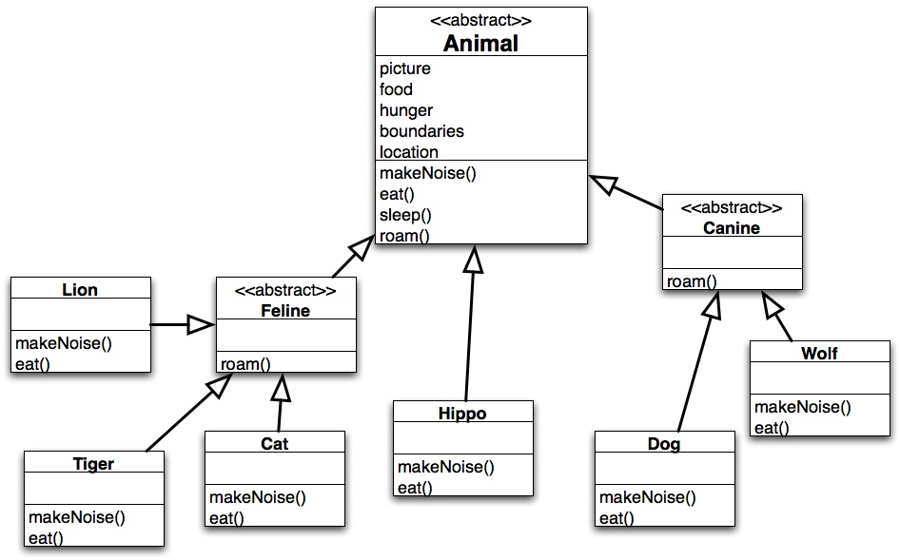
Assignment
Create the Animal
interface, Feline and Canine
abstract classes, and the
concrete animal classes.
Each should have a variable
and a method.
Create an object of each,
call all of the methods
for each object, and
observe the effects.

Slide 66
Exception Handling

Slide 67
Topics
Intro to Exception Handling
Try/Catch Blocks
Exception Messages
The Stack Trace
Handling Multiple Exceptions
Throws Clause
Throw Statement
Custom Exceptions
Finally Block

Slide 68
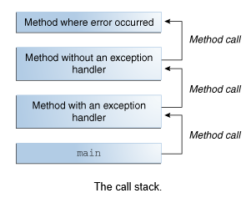
Intro to Exceptions
Exceptions are “exceptional events”
Exceptions disrupt normal execution flow
Methods create Exception objects for the JRE
Exception objects contain important information:
Exception type
State
Stack trace
JRE searches down the stack for an appropriate handler
If one is not found, the application terminates

Slide 69
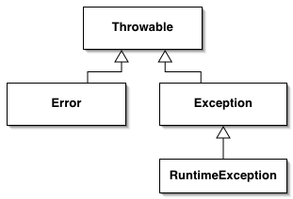
Exception Hierarchy
All Exceptions extend the Throwable class
Applications can recover from Exceptions
The compiler can anticipate Checked Exceptions
FileNotFoundException
IOException
The compiler cannot anticipate Unchecked Exceptions
These occur at runtime
ClassCastException
ArrayIndexOutOfBoundsException
Applications cannot reasonably recover from Errors
OutOfMemoryError
StackOverflowError
Checked
Unchecked

Slide 70
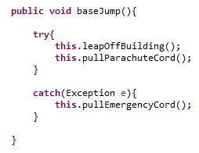

Try/Catch Blocks
Risky behavior is enclosed in a try block
Recovery procedures are in a catch block
If an exception is thrown:
Try block execution halts
JRE moves to the catch block
JRE must find a handler in the call stack
No handler = application termination

Slide 71
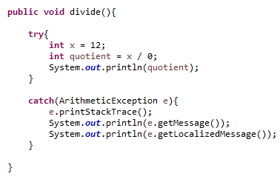
Exception Messages
Exception objects have many uses
Print a Stack Trace to the console
Get the Exception’s message
Get a Localized message
Used for internationalization

Slide 72
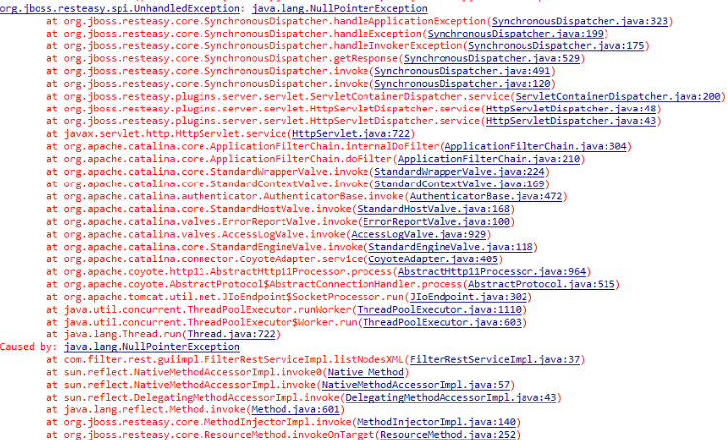
The Stack Trace
Get used to seeing me….

Slide 73
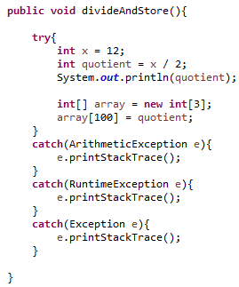
Handling Multiple Exceptions
Each try block can have multiple catch blocks
You can have as many as you want
The JRE checks from top to bottom
It will pick the first one that can catch the Exception
Always use specific Exception subclasses first!
More general exceptions should be last
RuntimeException
Exception

Slide 74




Throws Clause
Two choices when an exception is thrown:
Catch it
Duck it
Let someone else handle it.
Got it, bruh.

Slide 75
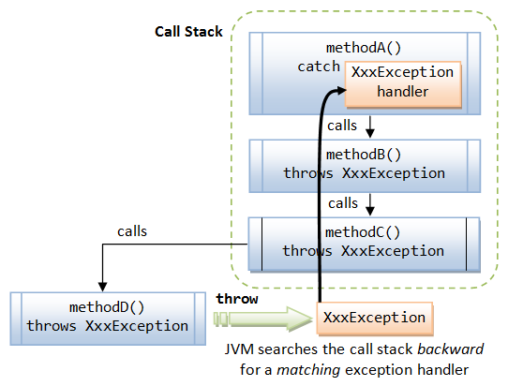
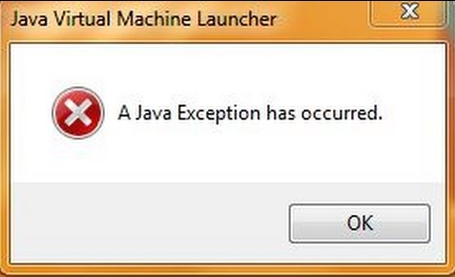
Ducking Exceptions
When a method ducks an exception:
JRE moves down the call stack
Searches for an appropriate handler
You can duck an exception many times
A handler must be reached somewhere, or:
The application terminates

Slide 76


Throw Statement
To manually throw an Exception
Creates an Exception-type object
Passes the object to the JRE
Is treated like any other exception occurrence
Useful when testing your code
Needed to throw custom exceptions

Slide 77
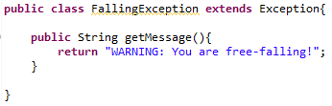
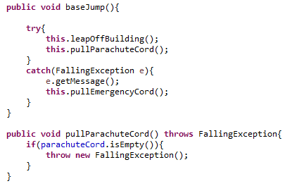
Custom Exceptions
Tailored to your application
Custom Exceptions are useful when:
The Exception type is not in Java API
Differentiation is necessary
Code throws too many related exceptions
Give users access to exceptions
Custom Exceptions are easy!
Create a class that extends any Exception type
Override any Throwable methods you want
Throw the exception in your code

Slide 78
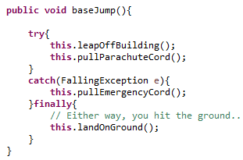
Finally Block
A finally block follows a try or catch block
Executes if an exception is thrown
Executes if an exception is NOT thrown
Used to close resources gracefully
Files
Databases
Network Connections
Optional block
But… a try block must have either a catch and/or a finally block

Slide 79

When Finally Does NOT Execute
If System.exit(0) is called in either try or catch block
Catastrophic error occurs
OutOfMemoryError
StackOverflowError
Fatal deployment environment
Other extreme hardware/software failures

Slide 80
Review
Intro to Exception Handling
Try/Catch Blocks
Exception Messages
The Stack Trace
Handling Multiple Exceptions
Throws Clause
Throw Statement
Custom Exceptions
Finally Block

Slide 81
Assignment
Create a custom exception class that overrides the getMessage( ) method
Create a class that manually throws an exception of your custom type
Use System.out.println( ) to note where you are in the control flow. Example: “Starting try block”, “Ending try block”, “Starting catch block”, etc.
Duck the exception at least once
Implement a finally block that prints a graceful goodbye message
Use the System.exit(0) command in the try block and rerun the application. Note the console output to see if the finally block executes.

